Slide 1
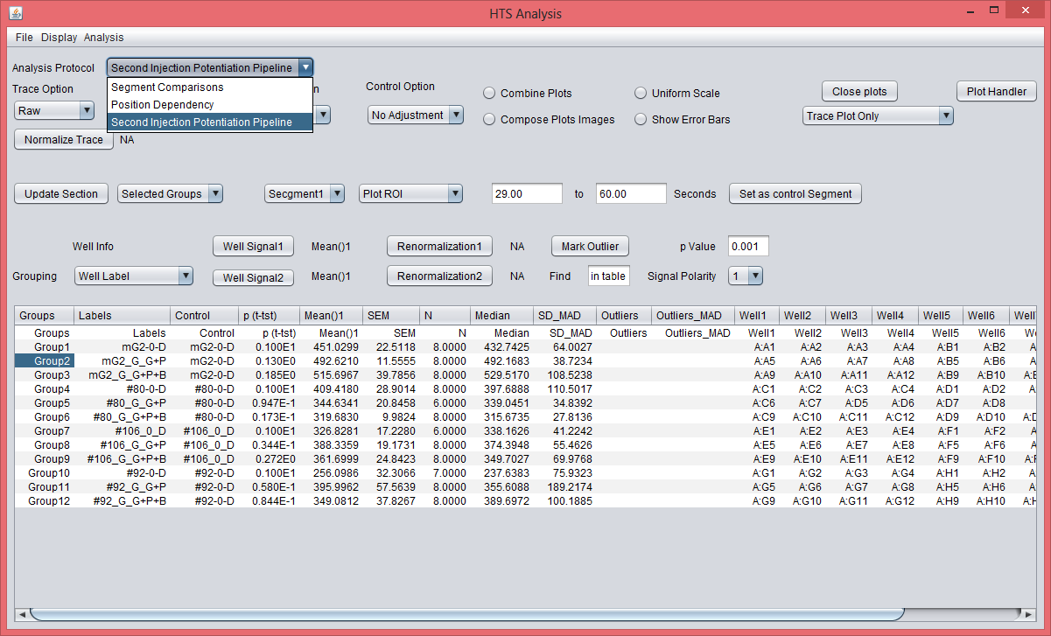
Second Injection Potentiation Pipeline:
To run the pipleline, select a group from table (by clicking any cell to highlight the group) then select option “Second Injection Potentiation Pipeline” from the drop-down list, Analysis Protocal. In the screenshot, Group2 is selected from the table.

Slide 2
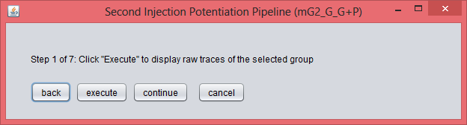
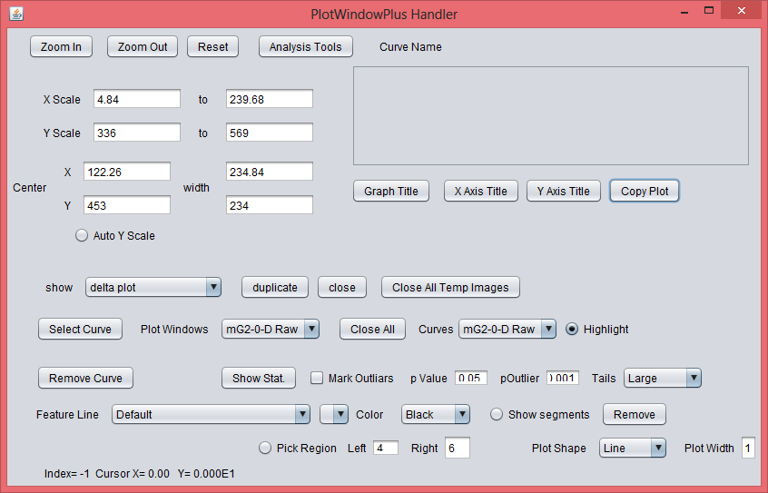
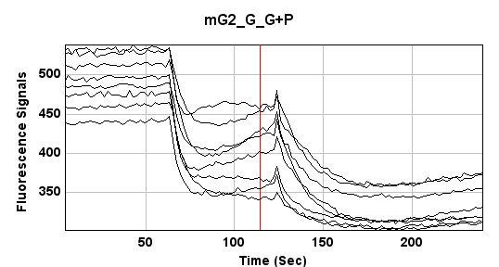
A small window titled “Second Injection Potentiation Pipeline (group name)” (left top pane) will appear by selecting the pipeline option. The window has four buttons, “back”, “execute”, “continue” and “cancel”. The prompt indicating the task of the pipeline at each step will appear above the buttons. Click the button “execute” to perform the task of the step. Click on “back” and “continue” will direct the pipeline to the previous and the subsequent step, respectively. Click on “cancel” button to cancel the pipeline at any step.
Step 1 of 7 : displaying the raw traces of the selected group (“mG2_G_G+P” in this example).
Titles of axis and the graph can be changed by click on the corresponding buttons on the interface PLotWindowPlus Handler (left panel betwo). This interface will appear when you draw any plot and it can also be displayed by clicking the button “Plot Handler” on the main interface shown on the first page. You can also set x and y scales by this interface by specify the scales in the text fields on the interface.

Slide 3
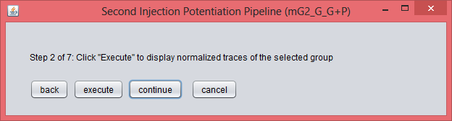
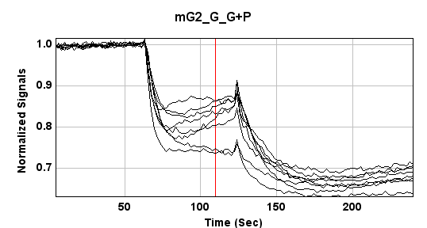
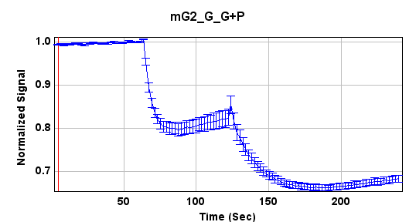
Step 2 of 7: displaying the mormalized traces of the selected group (“mG2_G_G+P” in this example). Two plots will be displayed by clicking “excute”, the individual traces (left) and the summary trace (right).

Slide 4
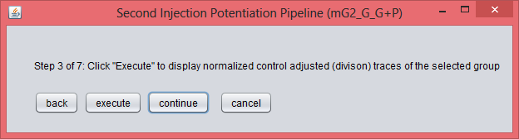
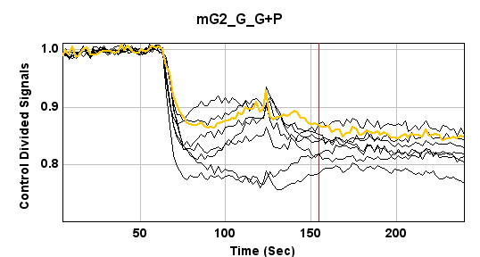
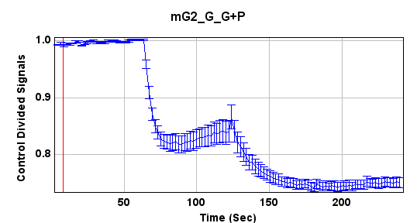
Step 3 of 7: displaying the mormalized and control adjusted (divided) traces of the selected group (“mG2_G_G+P” in this example). Two plots will be displayed by clicking “excute”, the individual traces (left) and the summary trace (right).

Slide 5
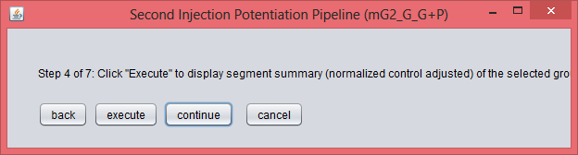
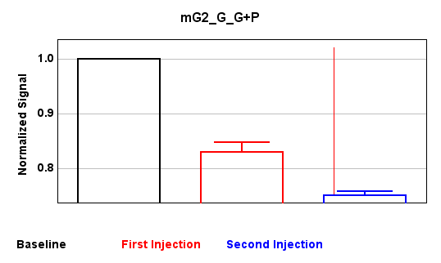
Step 4 of 7: displaying segment summary (normalized and control adjusted) of the selected group.

Slide 6
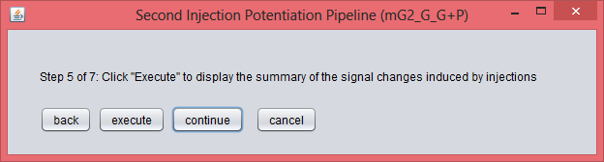
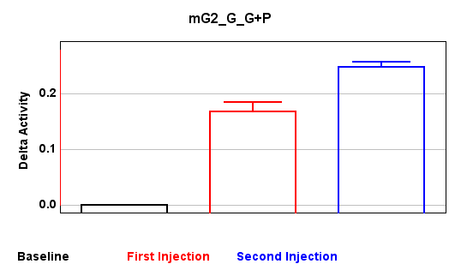
Step 5 of 7: displaying the signal changes induced by injections.

Slide 7
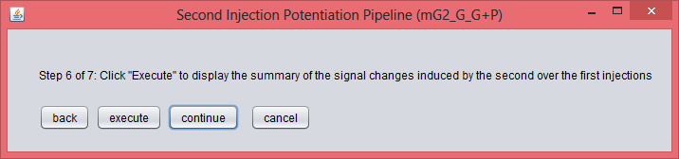
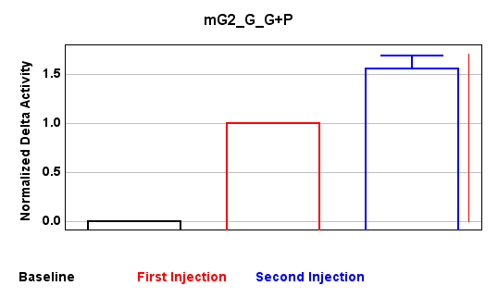
Step 6 of 7: displaying the summary of the ratio of the signal changes induced by the second injection over the first injection.

Slide 8
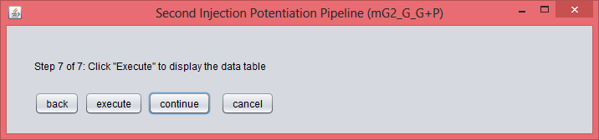
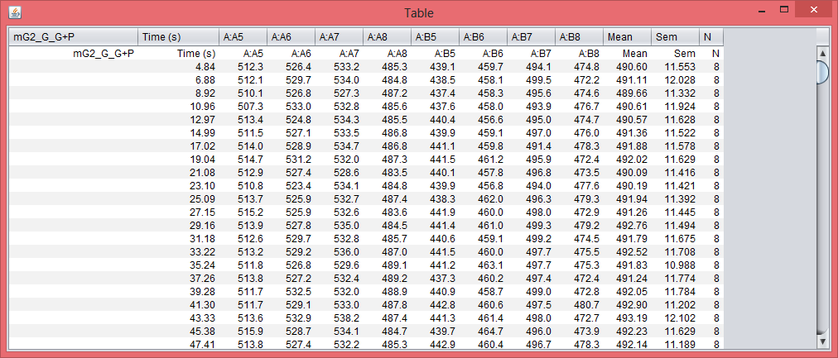
Step 7 of 7: displaying the data table. The data of all plots will be displayed in a table at the last step of the pipeline, which can be copy and pasted to excel or other software of your choice.
Below shows the data of the raw traces.

Slide 9
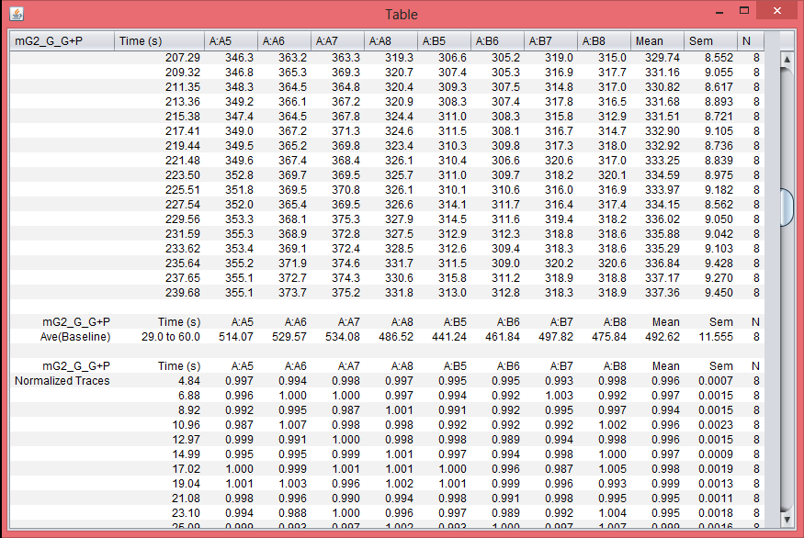
Step 7 of 7: displaying the data table. The data of all plots will be displayed in a table at the last step of the pipeline, which can be copy and pasted to excel or other software of your choice.
Below shows the data of the normalized traces.

Slide 10
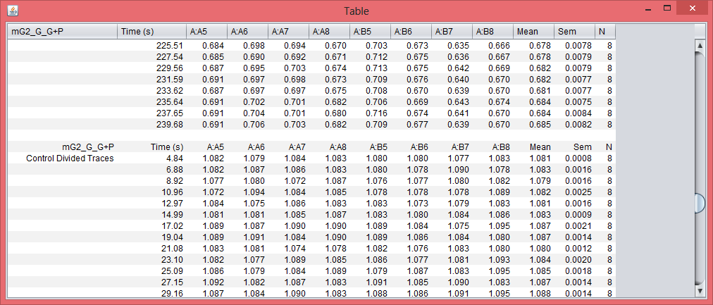
Step 7 of 7: displaying the data table. The data of all plots will be displayed in a table at the last step of the pipeline, which can be copy and pasted to excel or other software of your choice.
Below shows the data of the normalized and control adjusted traces.

Slide 11
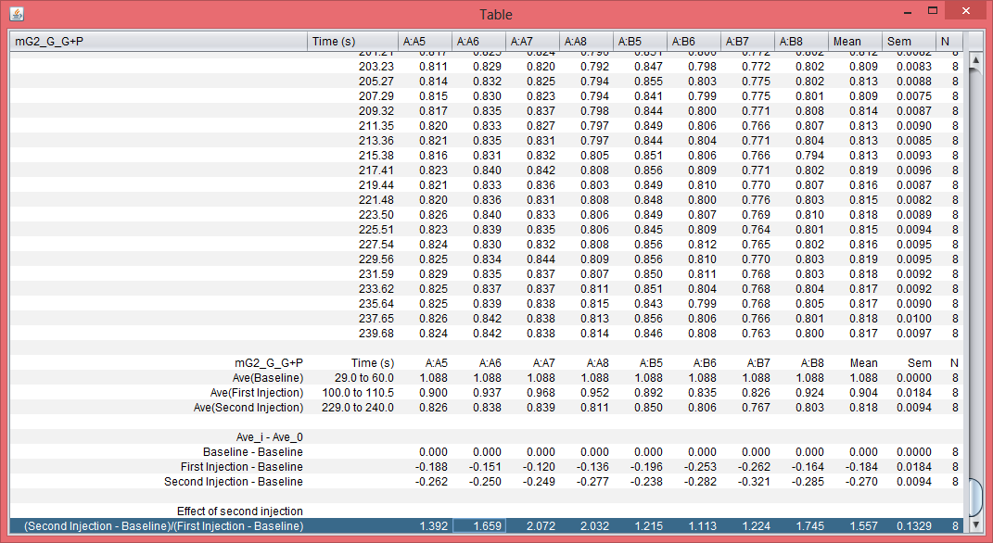
Step 7 of 7: displaying the data table. The data of all plots will be displayed in a table at the last step of the pipeline, which can be copy and pasted to excel or other software of your choice.
Below shows the data of the summary plots.

